Slide 1


Structures
Nazrin Dolkhanova Sultanli
Programming and Computer Applications – 1

Slide 2



Agenda
Define Structure
Access to Structure Members
Nested Structures
Structure Pointer
Functions & Structures
Array Structure

Slide 3

Topic seven
Structure

Slide 4
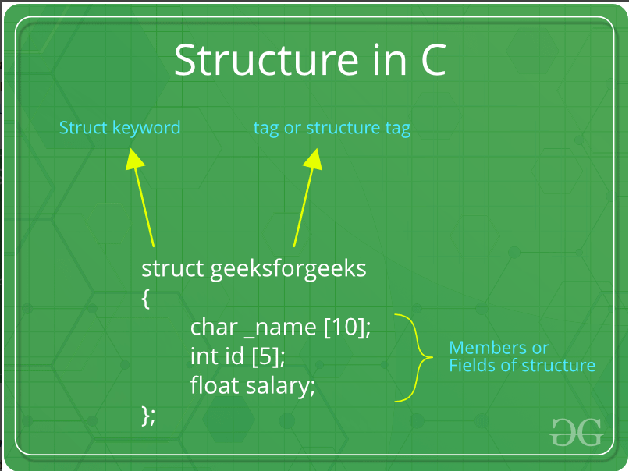
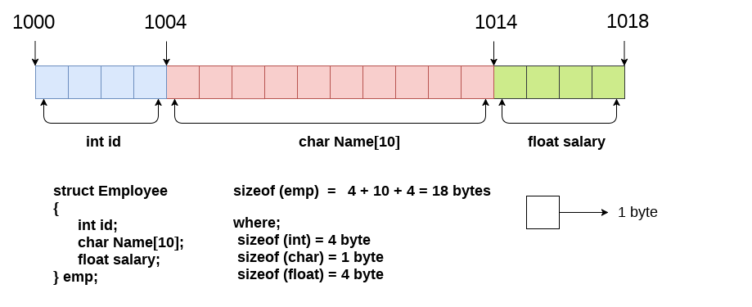
7.1 Define Structure
In C, a structure is a collection of one or more variables, possibly of different types, grouped together under a single name for convenient handling.
A structure is a key word that create user defined data type in C/C++. A structure creates a data type that can be used to group items of possibly different types into a single type.
way1 | way2
struct [structure tag] { member definition; member definition; ... member definition; } [one or more structure variables]; | struct structureName { dataType member1; dataType member2; ... dataType member2; };
struct Books { char title[50]; char author]; int book_id; } book1, book2, boo[5]; | struct address{ char name[50]; char street[100]; char state[20]; };
 | int main() { struct address addr1, add2, ad[20]; return 0; }

Slide 5
7.2 Access to Structure Members
way1 | way2
struct address{ char name[50]; char street[100]; int zip_code; }; int main() { struct address addr1; struct address addr2 = {“banm”, ”bibiheybet”, 2000}; printf(“enter street name: ”); scanf(“%99s”, addr1. street); addr1. zip_code = 1001 strcpy(addr1. name, “BHOS”); return 0; } | struct Books { char title[50]; char author[50]; int book_id; }; int main() { struct Books book1; struct Books *bookptr; bookptr = &book1; printf(“enter author: ”); scanf(“%49s”, book1. author); bookptr ->book_id = 472837; strcpy(bookptr-> title, “BHOS”); return 0; }
There are two types of operators used for accessing members of a structure.
. Member operator
-> Structure pointer operator

Slide 6
7.3 Nested Structures
way1 | way2
struct structureName1 { dataType member1; dataType member2; ... dataType memberN; }; struct structureName2 { dataType member11; dataType member22; struct structureName1 structure2_variable; } structure1_variable; | struct structureName1 { dataType member1; dataType member2; ... dataType memberN; struct structureName2 { dataType member11; dataType member22; dataType memberN; } structure2_variable; } structure1_variable;
Access to member22: structure1_variable. structure2_variable. member22; Pointer_structure1_variable-> structure2_variable. member22;
You can create structures within a structure in C programming

Slide 7
7.4 Functions & Structures
Passing structs to functions | Return struct from a function
struct address{ char name[50]; int zip_code; }; void PrintValue (struct address a){ printf("Name: %s; zip_code: %d\n", a.name, a. zip_code); } | struct address{ char name[50]; int zip_code; }; struct Student ScanValues(){ struct Student var; printf("Name: "); scanf("%49s", var.name); printf("zip_code: "); scanf("%d", &var. zip_code); return var; }
int main() { struct address addr2 = { “banm”, 2000 }; PrintValue (addr2 ); return 0; } | int main() { struct address addr2; addr2 = ScanValues(); return 0; }

Slide 8
7.5 Array Structure
struct address{ char name[50]; int zip_code; }; void PrintValue (struct address a){ printf("Name: %s; zip_code: %d\n", a.name, a. zip_code); } struct Student ScanValues(){ struct Student var; printf("Name: "); scanf("%49s", var.name); printf("zip_code: "); scanf("%d", &var. zip_code); return var; } | int main() { struct address addr[3]; for(int i=0; i<len; i++){ printf("\nScan values for student[%d]\n“ , i); students[i]=ScanValues(); printf("Print values for student[%d]\n",i ); PrintValue(students[i]); } return 0; }

Slide 9
7.6 Structure Pointer
Template | Example
struct structureName { dataType member1; dataType member2; ... dataType member2; }; | struct address{ char name[50]; int zip_code; }; void PrintValue (struct address *p_a){ printf("Name: %s; zip_code: %d\n", p_a->name, p_a->zip_code); }
int main() { struct address structure_variable; struct address *ptr_structure_variable; ptr_structure_variable=&structure_variable; //access to the members ptr_structure_variable->member1 return 0; } | int main() { struct address add; struct address *ptr_add; strcpy(ptr_add->name, “BANM"); ptr_add->zip_code = 18; PrintValue(ptr_add); return 0; }

Slide 10

References
Each Reference is indicated on the footer on each slide.
Books:
The_C_Programming_Language_(2nd_Edition_Ritchie_Kernighan)
Learn to Program with C_ Learn to Program using the Popular C Programming Language (Noel Kalicharan)
C How to Program, 8th edition, Paul Deitel and Harvey Deitel, Pearson, 2016.

Slide 11


Thank You
Nazrin Dolkhanova Sultanli
Nazrin.Sultanli.Dolkhanova@bhos.edu.az
Baku Higher Oil School

